Slide 1
Vertical Axis Wind Turbine Performance Prediction
via Artificial Neural Network
Batuhan Atasoy, Ezgi Demir, Oğuz Susam
MAK 660 E
2021 ITU

Slide 2
Outline
Aerodynamics of H-rotor Turbines
Performance Evaluation of H-rotor Turbines
The Numerical Method
The Database for First Analysis
The Database for Second Analysis
Results of NNtool
Results of TensorFlow
Conclusions

Slide 3
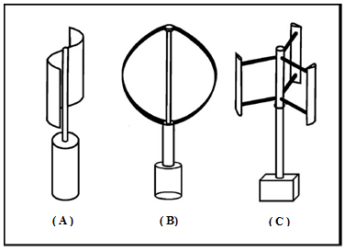
H-rotor Turbines
(A) Savonius turbine: Drag Driven
(B) Darrieus turbine: Lift Driven
(C) H-rotor(Straight Bladed Darrieus) turbine: Lift Driven
Picture : Eriksson, S., Bernhoff, H. ve Leijon, M. (2008). Evaluation of different turbine concepts for wind power, Renewable and Sustainable Energy
Reviews, 12(5), 1419 – 1434, http://www.sciencedirect.com/science/article/pii/S1364032107000111.

Slide 4
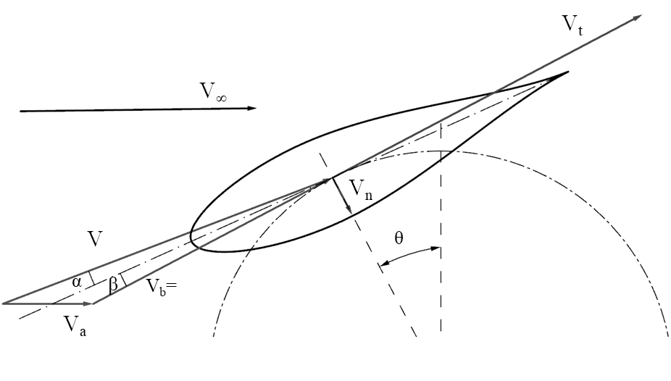
Aerodynamics of H-rotor Turbines

Slide 5
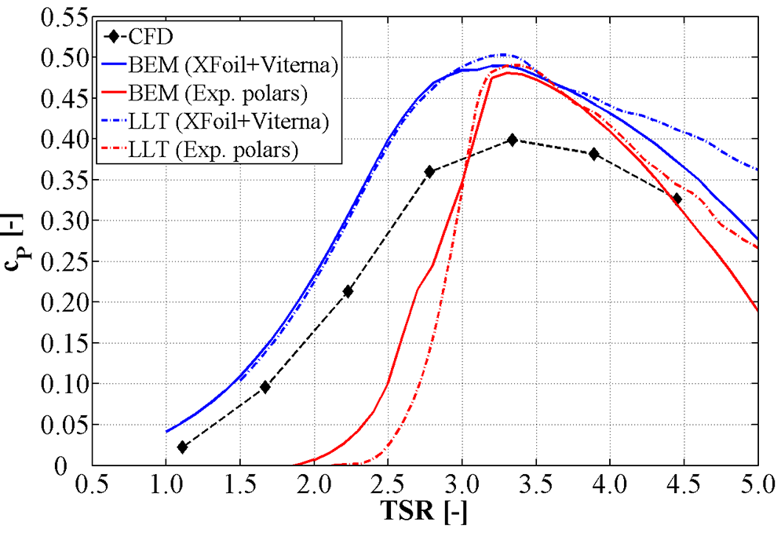
The Performance Curves
Power Coefficient: Power of wind / The torque generated on the blades * angular velocity
Cp ----> efficiency!!!
TSR : linear velocity of the blades / Uinf
Picture : Eriksson, S., Bernhoff, H. ve Leijon, M. (2008). Evaluation of different turbine concepts for wind power, Renewable and Sustainable Energy
Reviews, 12(5), 1419 – 1434, http://www.sciencedirect.com/science/article/pii/S1364032107000111.

Slide 6
The Numerical Method
Potential Flows based on some assumptions
Irrotational
Inviscid ( alike non-frictional)
Linear
Double multiple-streamtube model (DMST)
Advantages
3D (in Qblade even more developed, some semi empirical corrections)
CHEAP!!! (in CFD, a 2D analysis can be completed 1-2 days with a standart laptop)
Disadvantages (in comparison with CFD)
Inviscid
Non-turbulent
Overprediction
Unsatisfied results at extreme TSRs because of lackness of dynamic stall model and turbulent model
QBlade 64bit v0.963 (Berlin TU)

Slide 7
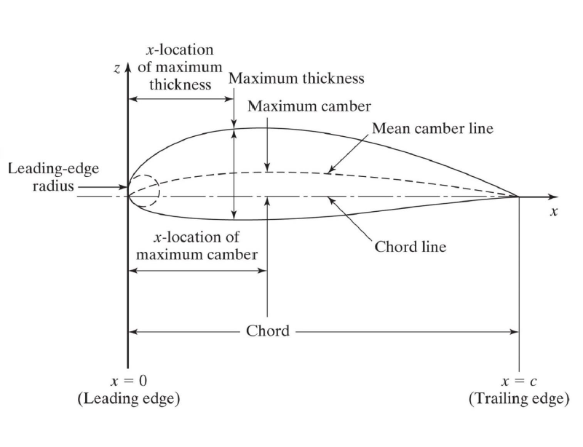
Data Generation-I
Flow Parameters
TSR (1~7, 0.25)
Global Parameters
Blade Number (2,3,4)---->classes
Rotor Diameter (0.5, 1, 1.5, 2) ----->classes
Foil Geometry
sigma
chord length/rotor diameter
0.18-0.72
tau
blade thickness/chord length
0.12-0.21Ref:SPC307-Introduction to Aerodynamics
Output: Cp
Picture : Eriksson, S., Bernhoff, H. ve Leijon, M. (2008). Evaluation of different turbine concepts for wind power, Renewable and Sustainable Energy
Reviews, 12(5), 1419 – 1434, http://www.sciencedirect.com/science/article/pii/S1364032107000111.

Slide 8
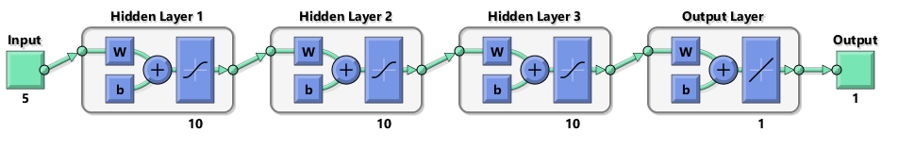
ANN with NNtool
1 input, 3 hidden and 1 output layers
activation fun.s are TANSIG and PURELIN
optimizer : GDM
loss : mse
max_fail : 100

Slide 9
NNtool
Feed-forward backpropagation
Training function
Levenberg-Marquardt
Scaled-conjugate gradient
Learning function
Gradient-descent momentum
Training evaluation
MSE : metric
Max_fail no. in validation : preventing overfit :6, 100, 150
Linear regression
Number of neurons in hidden layer
5,10
Number of layers
1,3
DATA
3975 samples
part. ratio : %70
train: 2783
part. ratio : %80
train: 3179
part. ratio : %90
train: 3577
with a data manipulation (Cp>0)
with a data manipulation (Cp>0.01)

Slide 10
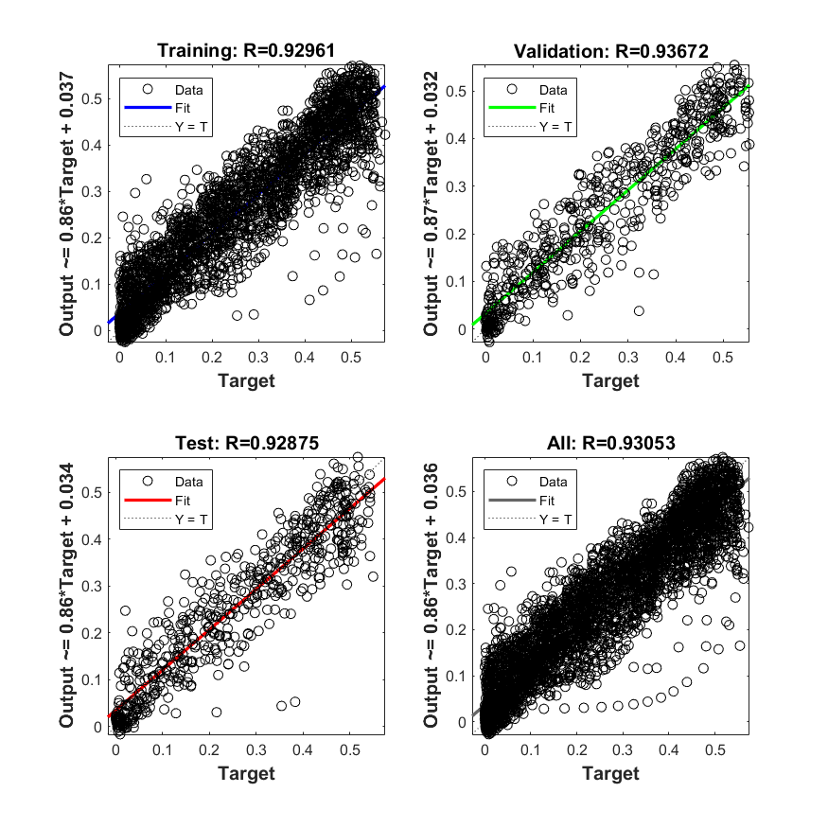
NNtool-Part. Rat %100
Training function
Scaled-conjugate gradient
Learning function
Gradient-descent
Training evaluation
MSE :
Max_fail no. in validation : 6
Number of neurons in hidden layer
5
Number of hidden layers
1

Slide 11
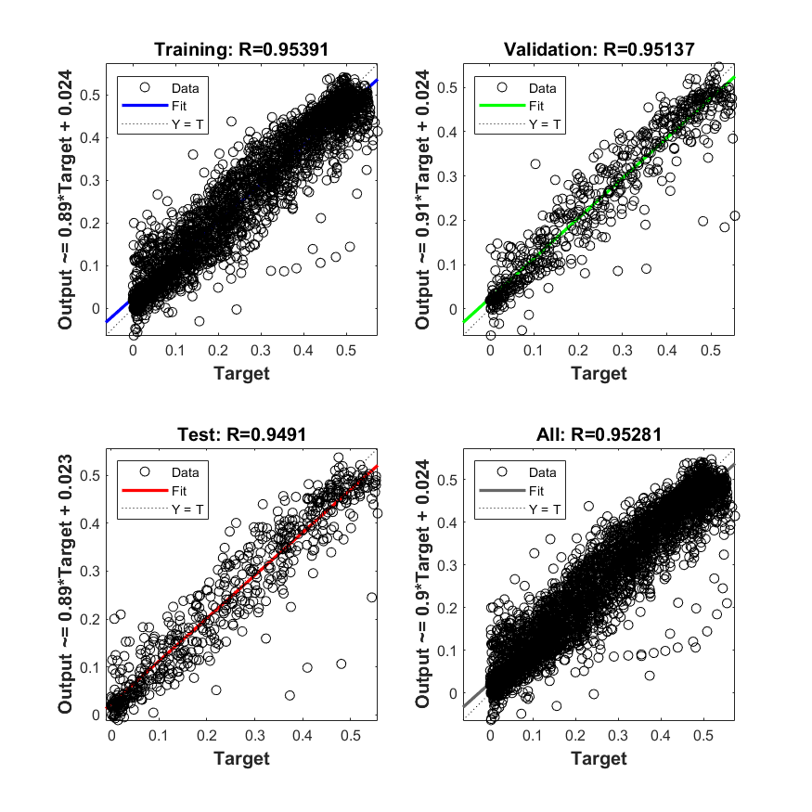
NNtool-Part. Rat %100
Training function
Levenberg-Marquardt
Learning function
Gradient-descent
Training evaluation
MSE :
Max_fail no. in validation : 6
Number of neurons in hidden layer
5
Number of layers
1

Slide 12
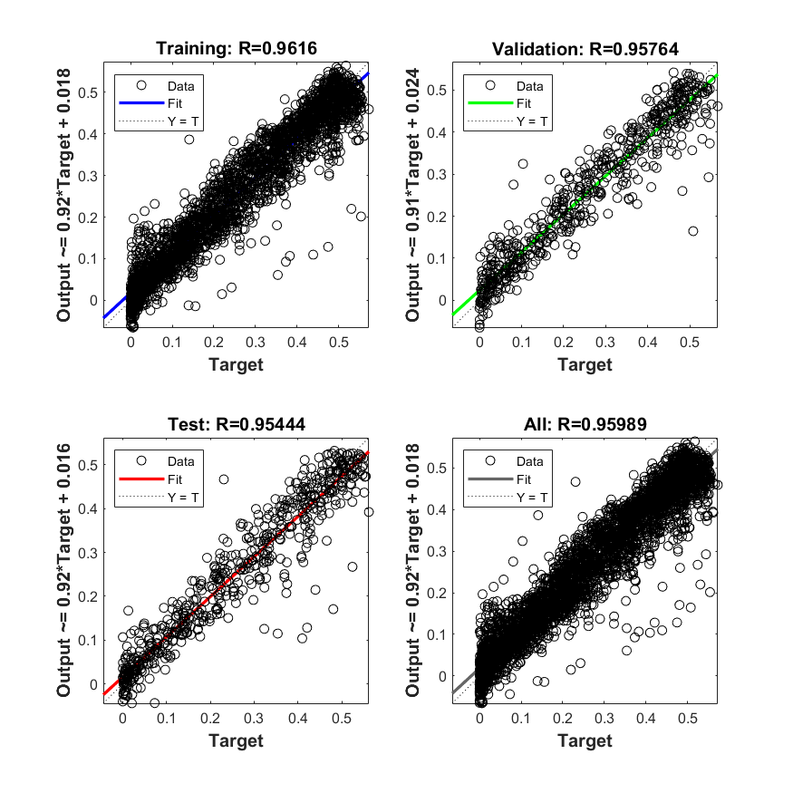
NNtool-Part. Rat %100
Training function
Levenberg-Marquardt
Learning function
Gradient-descent momentum
Training evaluation
MSE :
Max_fail no. in validation : 6
Number of neurons in hidden layer
10
Number of layers
1

Slide 13
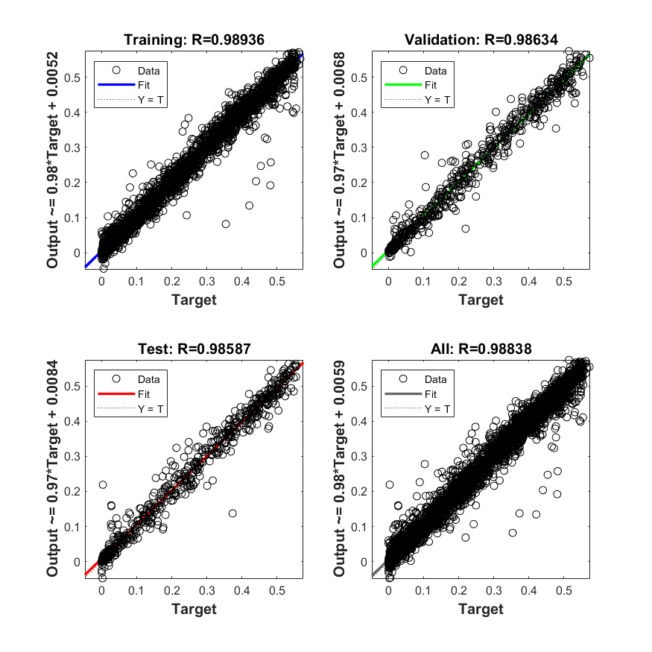
NNtool-Part. Rat %100
Training function
Levenberg-Marquardt
Learning function
Gradient-descent momentum
Training evaluation
MSE :
Max_fail no. in validation : 6
Number of neurons in hidden layer
10
Number of layers
3

Slide 14
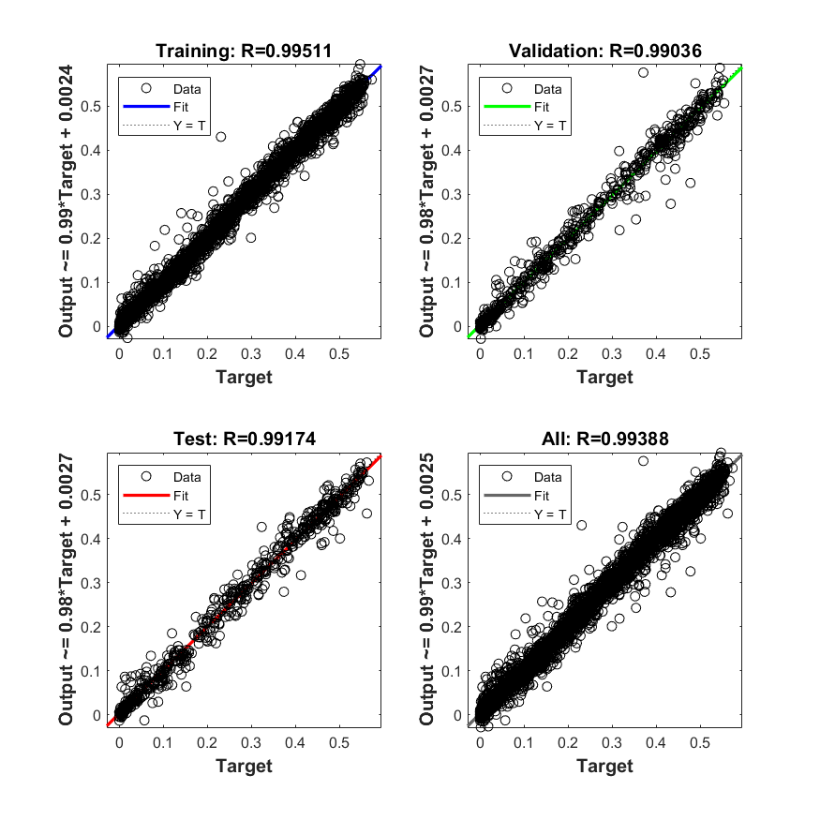
NNtool-Part. Rat %100
Training function
Levenberg-Marquardt
Learning function
Gradient-descent momentum
Training evaluation
MSE :
Max_fail no. in validation : 100
Number of neurons in hidden layer
10
Number of layers
3

Slide 15
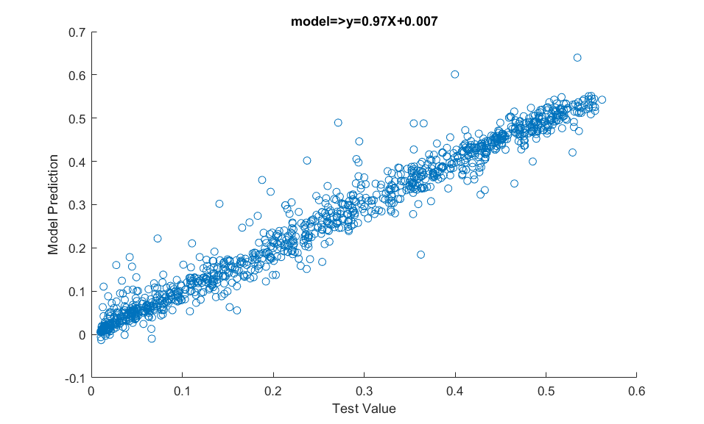
NNTool- Part. Rat. %70-R

Slide 16
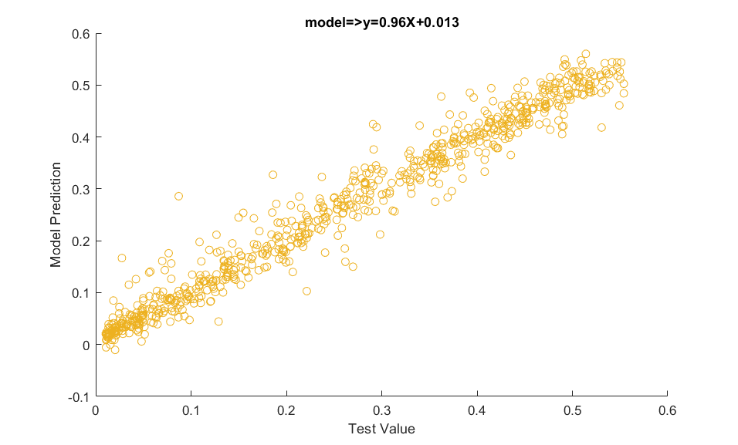
NNTool- Part. Rat. %80-R

Slide 17
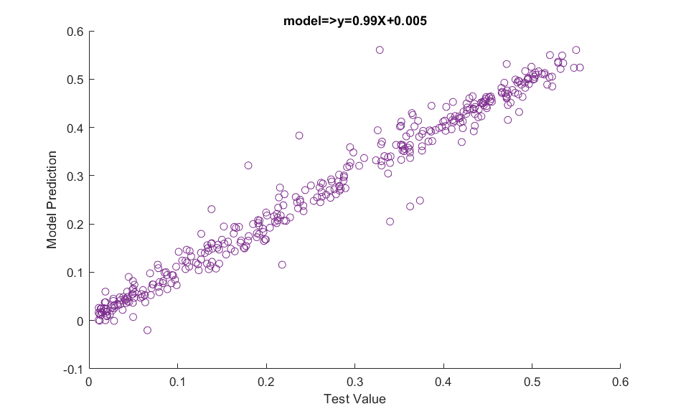
NNTool- Part. Rat. %90-R

Slide 18
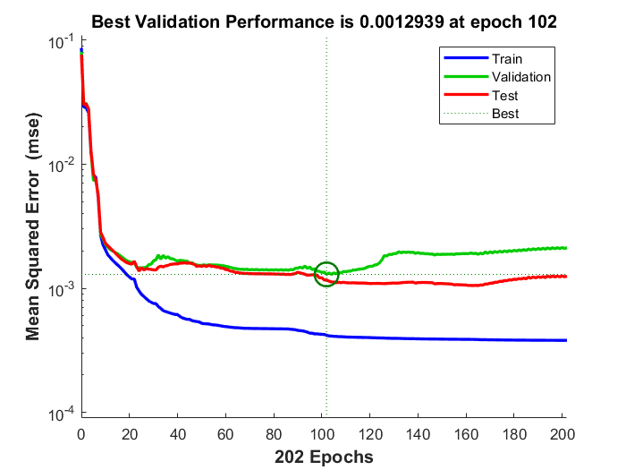
NNtool- Loss functions

Slide 19
ANN with TensorFlow
1 input, 3 hidden and 1 output layers
activation fun.s are tanh and relu
optimizer : adam
loss : mse
metrics : mse

Slide 20
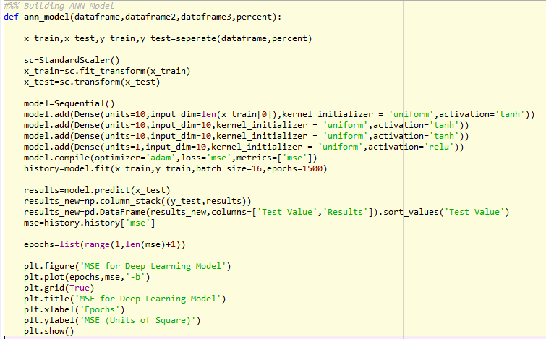
ANN with TensorFlow

Slide 21
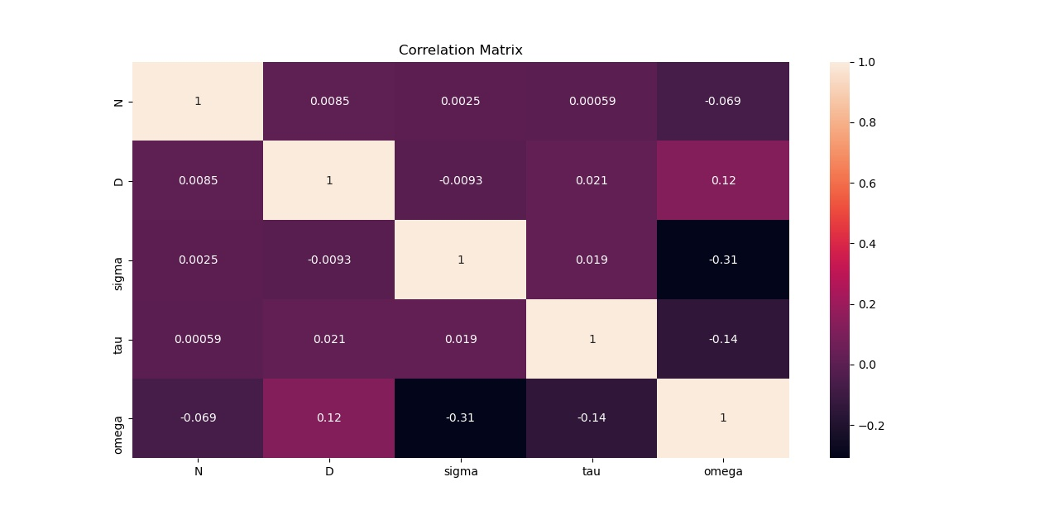
ANN with TensorFlow
Correlation matrix enables us to see the collinearity of the data, so it enables to select the features having a correlation of less than 0.85.

Slide 22
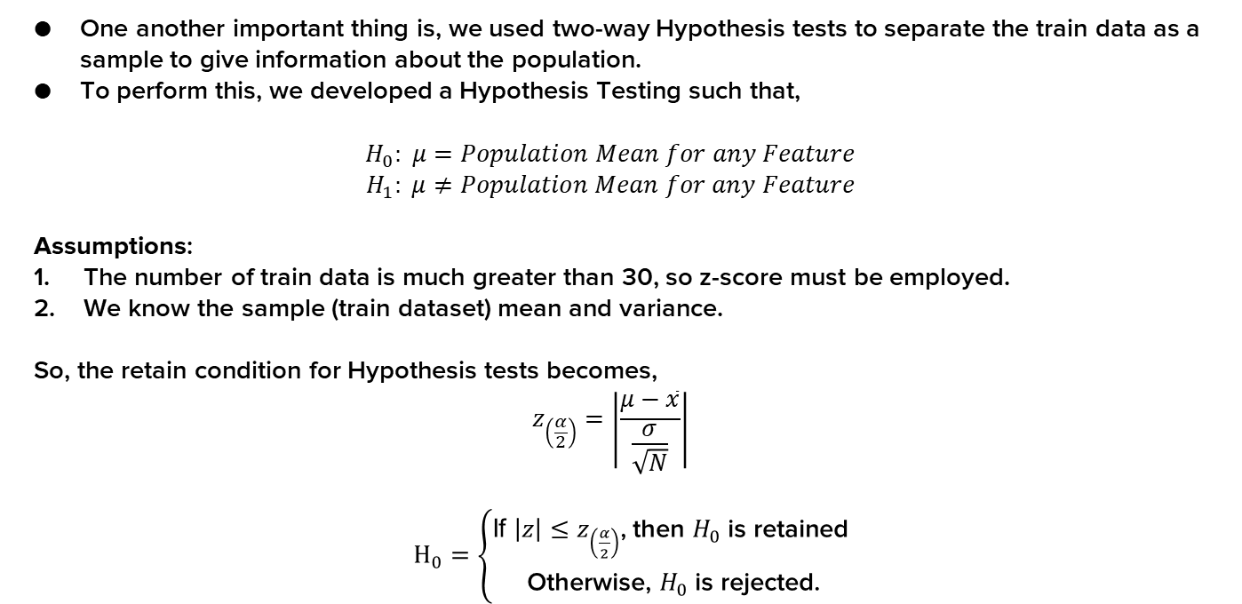
ANN with TensorFlow
One another important thing is, we used two-way Hypothesis tests to separate the train data as a sample to give information about the population.
To perform this, we developed a Hypothesis Testing such that,
$$H_{0}: μ=Population Mean for any Feature$$
$$H_{1}: μ≠Population Mean for any Feature$$
Assumptions:
The number of train data is much greater than 30, so z-score must be employed.
We know the sample (train dataset) mean and variance.
So, the retain condition for Hypothesis tests becomes,
$$z_{\left(\frac{α}{2}\right)}=\left|\frac{μ−\overline{x}}{\frac{σ}{\sqrt{N}}}\right|$$
$H_{0}=\left\{\begin{aligned}\text{If} \left|z\right|≤z_{\left(\frac{α}{2}\right)}\text{ , }\text{then} H_{0} \text{is} \text{retained} \\ \text{Otherwise}\text{ , }H_{0} \text{is} \text{rejected}\text{.}\end{aligned}\right.$

Slide 23
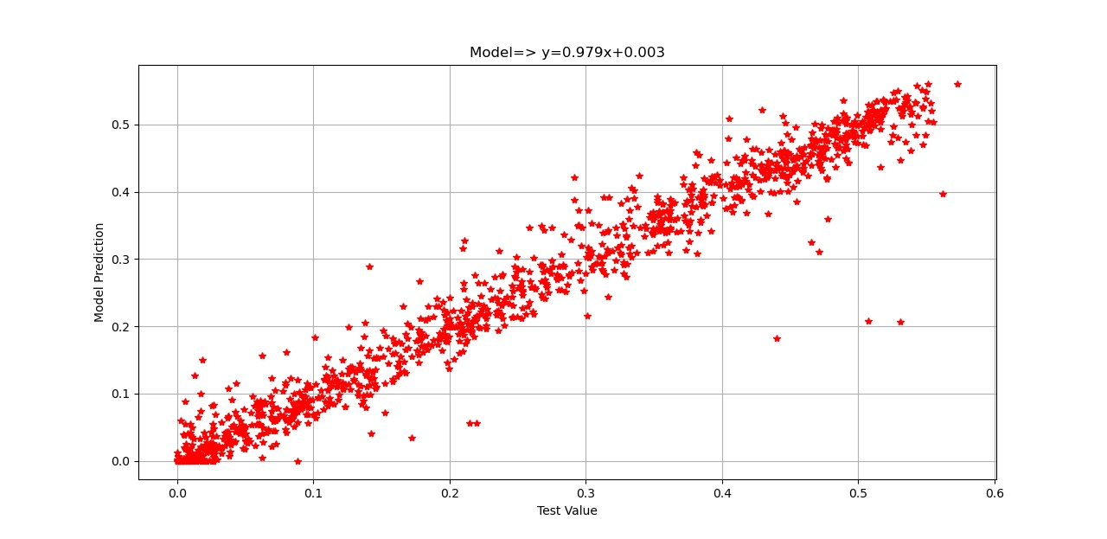
TensorFlow- Part. Rat. %70-R

Slide 24
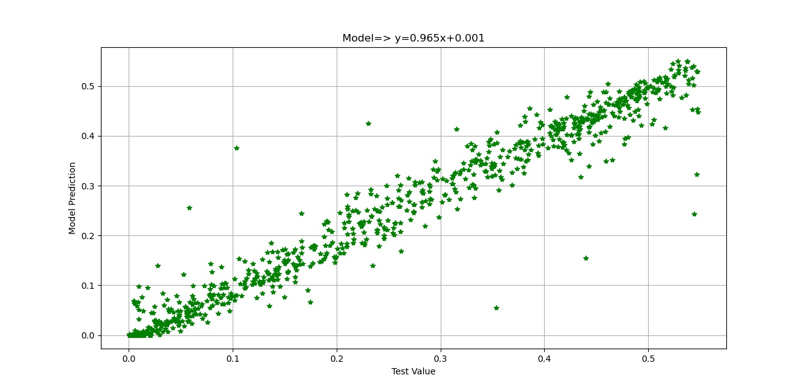
TensorFlow- Part. Rat. %80-R

Slide 25
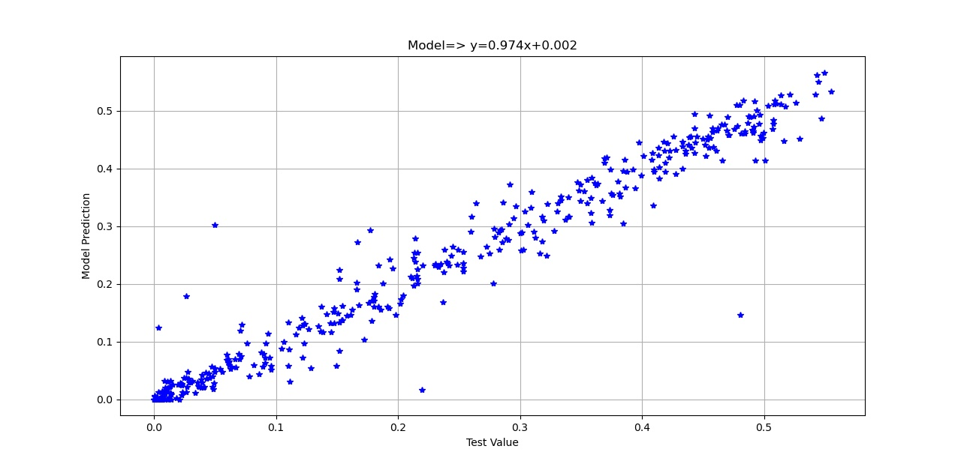
TensorFlow- Part. Rat. %90-R

Slide 26
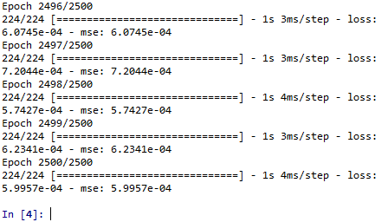
TensorFlow- Loss functions
After 2500 epochs, the loss function approaches 10^-4 interval, as given in figure below:

Slide 27
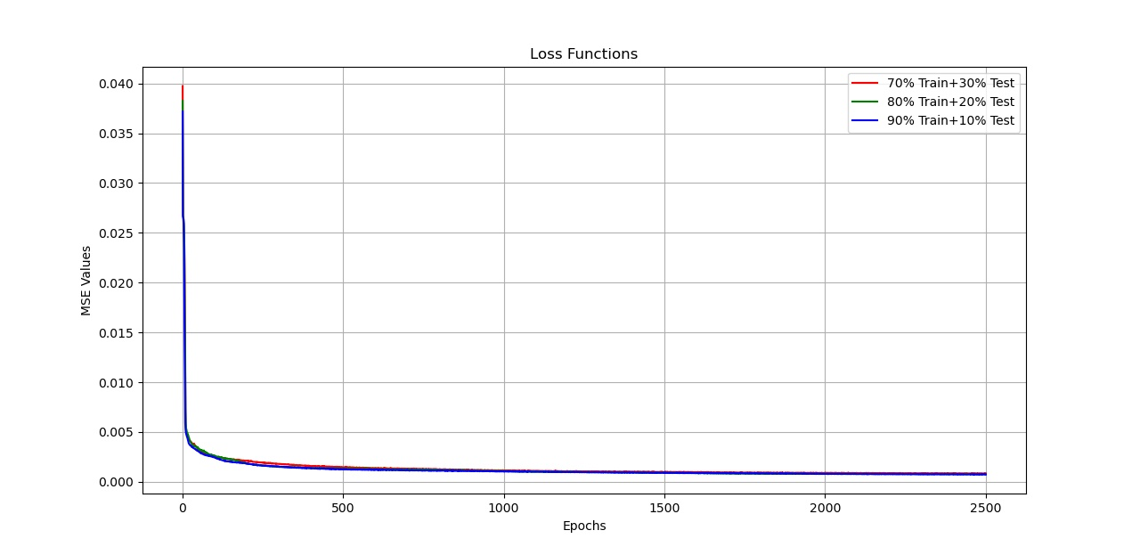
TensorFlow- Loss functions

Slide 28
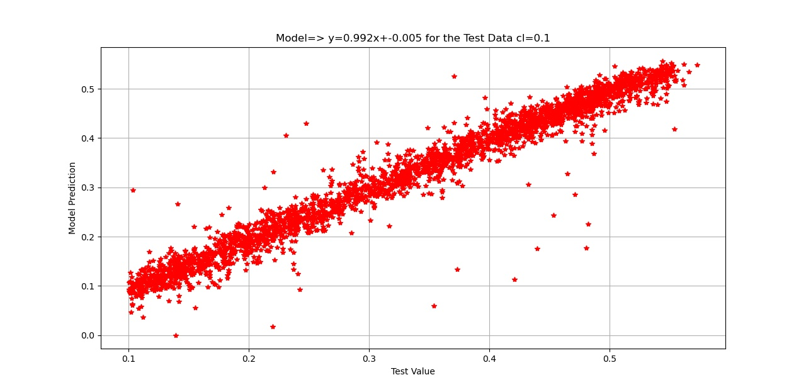
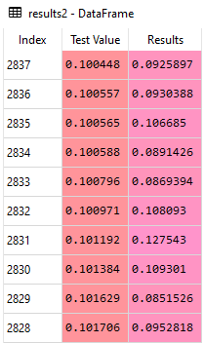
TensorFlow- Results for cl=0.1
At the second part of the analyses, we used cl=0.1 data and cl=0.2 data to validate our model:

Slide 29
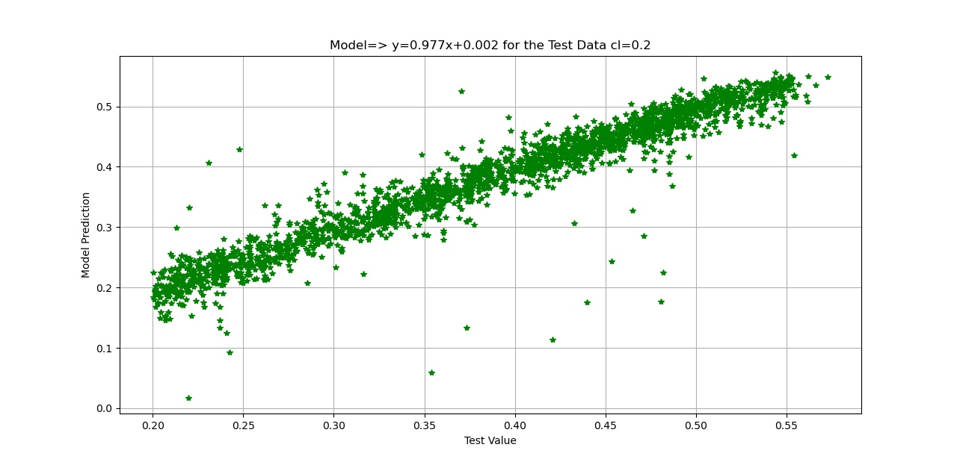
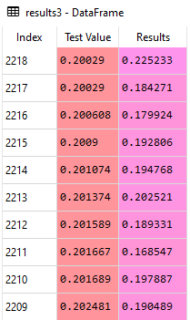
TensorFlow- Results for cl=0.2

Slide 30
Conclusions
Numerical Method
it is very fast
convenient to generate data in preliminary stages
the study can be expanded with CFD and turbulent models
method can be developed with semi-empirical dynamics stall models such as Beddoes-Leishman model
ANN model
The best results obtained by Levenbert Marquardt training function
Also SCG model gives acceptable results (R>0.92)
Although the one hidden layer is satisfied, but increasing the layer numbers made the model exceptional (R from 0.96 to 0.99)

Slide 31
Conclusions
Tools
The model was trained in about 150-200 epochs for MATLAB, 2500 epochs for Python
NNtool is very simple to use
On the other hand, TensorFlow more sophisticated tool and it requires moderate Python skills
TensorFlow is FREE!!
With the help CUDA-support, TensorFlow can also handle big data and much more sophisticated hidden layers and neurons.
Future works and Utilization in real life
Capability of ANN to predict wind turbine performance
Necessity of ANN modeling as a metamodel
Neuro-Fuzzy methods in turbine control and blade design

Slide 32
Thank you for listening!

